Slide 1
Data Science Presentation
By Davin Miller

Slide 2
Validating data
Cleared all Data with 999999 station_id value (represents an unmarked station).
With more time: removing invalid precipitation data (indicated by 8 or 9)

Slide 3
Indiana data
Max temperature found: 127.4
Mean is 62.55 and standard deviation is 20.4
Occurred on 9/30/2004
Max Wind Gust: 85.5
Mean is 23.187 and standard deviation is 6.522
Occurred on 2/21/2014
Max Precipitation: 99.99
Mean is 13.48 and standard deviation is 34.056
Occurred on 11/08/1941

Slide 4
More data

Slide 5
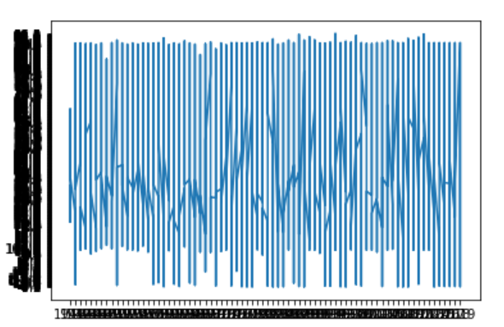
Graph
More useful: mean temperature per year

